Slide 1
Working Assistance Platform
Usability Study Highlights Video
Team member:
Rusu Wu
Jianqiao Liu
Wen-Chih Li
Parikshit Panwar
Yi Yao
Jinyang Ruan

Slide 2
5 core tasks:
Clock in/out
Check monthly attendance report
Add a particular event
Ask for leave and business trip with specific information
Chat with friend and company group. Create and join company groups. Search and add new friends.

Slide 3
Task 1 : Clock in/ clock out
Task description:
Clock in and click out on the attendance page

Slide 4
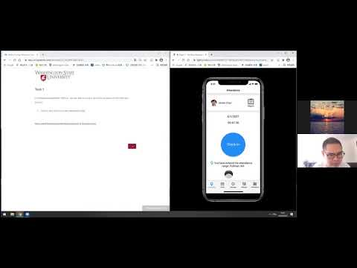
Task 1 : Clock in/ clock out
No usability problems were detected

Slide 5
Task 2 : Check monthly attendance report
Task description:
Check monthly attendance report
Check "attendance report" on the "attendance" page.
Check your "clock in calendar" on the "monthly attendance report" page.
Go back to "attendance" page.

Slide 6
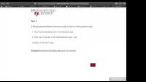
Task 2: Checking monthly attendance report
Problem: The attendance report button on the top right is confusing.
Severity level: 1
Scope level: 2(2/5 participants)
Critical incident video clip -->

Slide 7
Task 3 : Add the new events to the calendar
Task description:
Go to "event" page and add an event with the following information:
Title: Reporting.
Starting time: 04/05/2021 10:00.
Ending time: 04/05/2021 11:30.
Invite participants: Jimmy and Tom.
Set the reporting location: Manager office.
Submit the event.

Slide 8
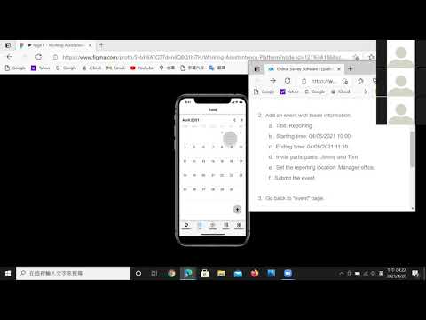
Task 3 : Add the new events to the calendar
Problem: "+" button is not understandable , which is required to add an event
Severity level: 1
Scope level: 2 (3/5 participants)
Critical incident video clip -->

Slide 9
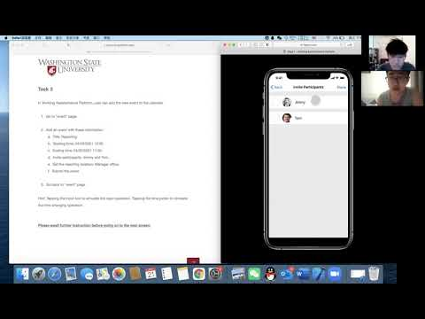
Task 3 : Add the new events to the calendar
Problem: Users fail to select participants if they click on the profile photos
Severity level: 3
Scope level: 3 (2/5 participants)
Critical incident video clip -->

Slide 10
Task 4 : Ask for a leave and request business trip.
Task description:
Go to "request" page. Ask for a leave with the following information:
Reason: Visit dentist.
Starting time: 04/08/2021 09:00.
Ending time: 04/08/2021 12:00.
Go back to "request" page. Ask for a business trip with the following information:
Reason: Provide face-to-face guidance to users.
Location: Washington-Seattle.
Starting time: 04/12/2021 09:00.
Ending time: 04/15/2021 17:30.
Then review it.

Slide 11
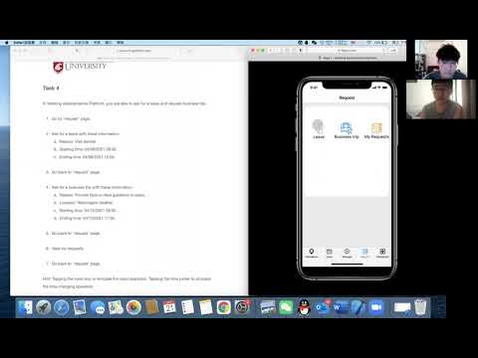
Task 4 : Ask for a leave and request business trip.
Problem: Users may click “Done” button to submit the request without finishing all required information.
Severity level: 2
Scope level: 2 (2/5 participants)
Critical incident video clip -->

Slide 12
Task 5 : Chatting, Creating and joining groups, Adding friends.
Task description:
To chat with friends and teams. create and join groups, add friends.
Go to "message" page. Chat with "Jimmy”.
Chat in the "Human-Computer Interaction" group.
Go to "contacts" page to create a company group with the following information:
name: Washington State University.
Size: >1000.
Location: Washington-Pullman.
4.Search and join the group with name "Washington University"
5.Search and add the contact with name "Benedict Cumberbatch".

Slide 13
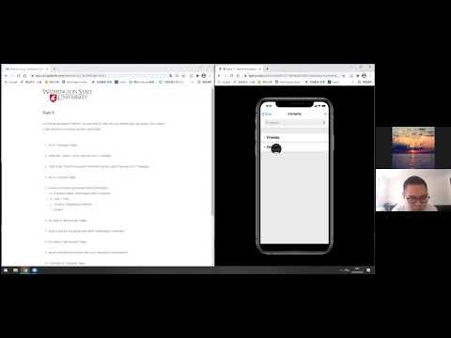
Task 5 : Chatting, Creating and joining groups, Adding friends.
Problem: Users may not notice the “+” button to click to add new contacts
Severity level: 2
Scope level: 2 (2/5 participants)
Critical incident video clip -->

Slide 14
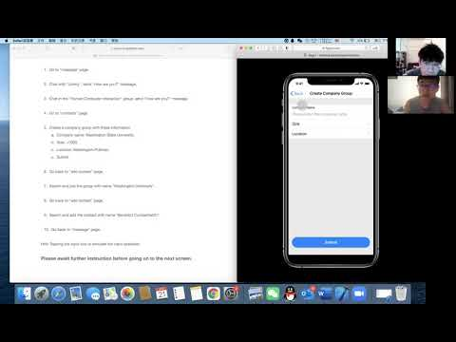
Task 5 : Chatting, Creating and joining groups, Adding friends.
Problem: Users confused about how to search and add an individual contact
Severity level: 2
Scope level: 3(1/5 participants)
Critical incident video clip -->

